Slide 1
Incremental Learning in Intrusion Detection Systems
Varun P. Malhotra

Slide 2
Problem Statement
Cybersecurity is a rapidly moving field where accurate and rapid response is of utmost importance in Intrusion Detection Systems in the face of newer and newer threat types/classes
Apply Incremental/Continual learning to Deep Learning models trained on IDS data
Focus on Deep Learning? Observe ‘catastrophic forgetting’ where past tasks are forgotten/accuracy greatly decreases on learning of new tasks.
Basis of experiments: class-incremental split - incrementally feeding new classes to base trained model 1-by-1

Slide 3
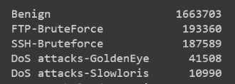
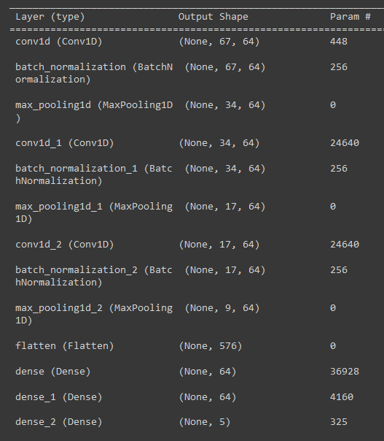
Methodology
Base model: CNN
Total classes: 5 (data from day 1 and 2 of CIC_IDS_2018)
Split dataset into class subsets, divided into tasks
Sequentially train model on tasks, 1 by 1
Designed to introduce a new class to the model with each task
Base model is trained on Benign + class 1

Slide 4
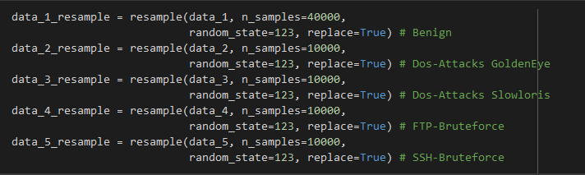
Preprocessing
Remove categorical features, specifically testing numerical features
Remove static features with constant values across all samples
Modify feature values of N/A (set to feature minimum) and Inf (set to feature maximum)
Total of 67 features after pre-processing, down from 80
Use one hot encoding for each of the classes
Image shows broad sampling of data used over all experiments, actual splits varied

Slide 5
Experiments
3 broad experiments:
Baseline test: train on all class data at once
Incremental 1: Class-split tasks, Split b/w Benign and Attack for each task
Incremental 2: Class split tasks with Replay, Split b/w new Attack and samples from previously learned classes
Varied split sizes analyzed for each
CNN designed with 5 classes/output layers from the beginning
Model tested on same test data after each task: 4000 Benign + 1000 of each of the 4 attack types = 8000 samples
Remaining data used for training: 36000 Benign + 9000 of each of the 4 attack types = 72,000 samples

Slide 6
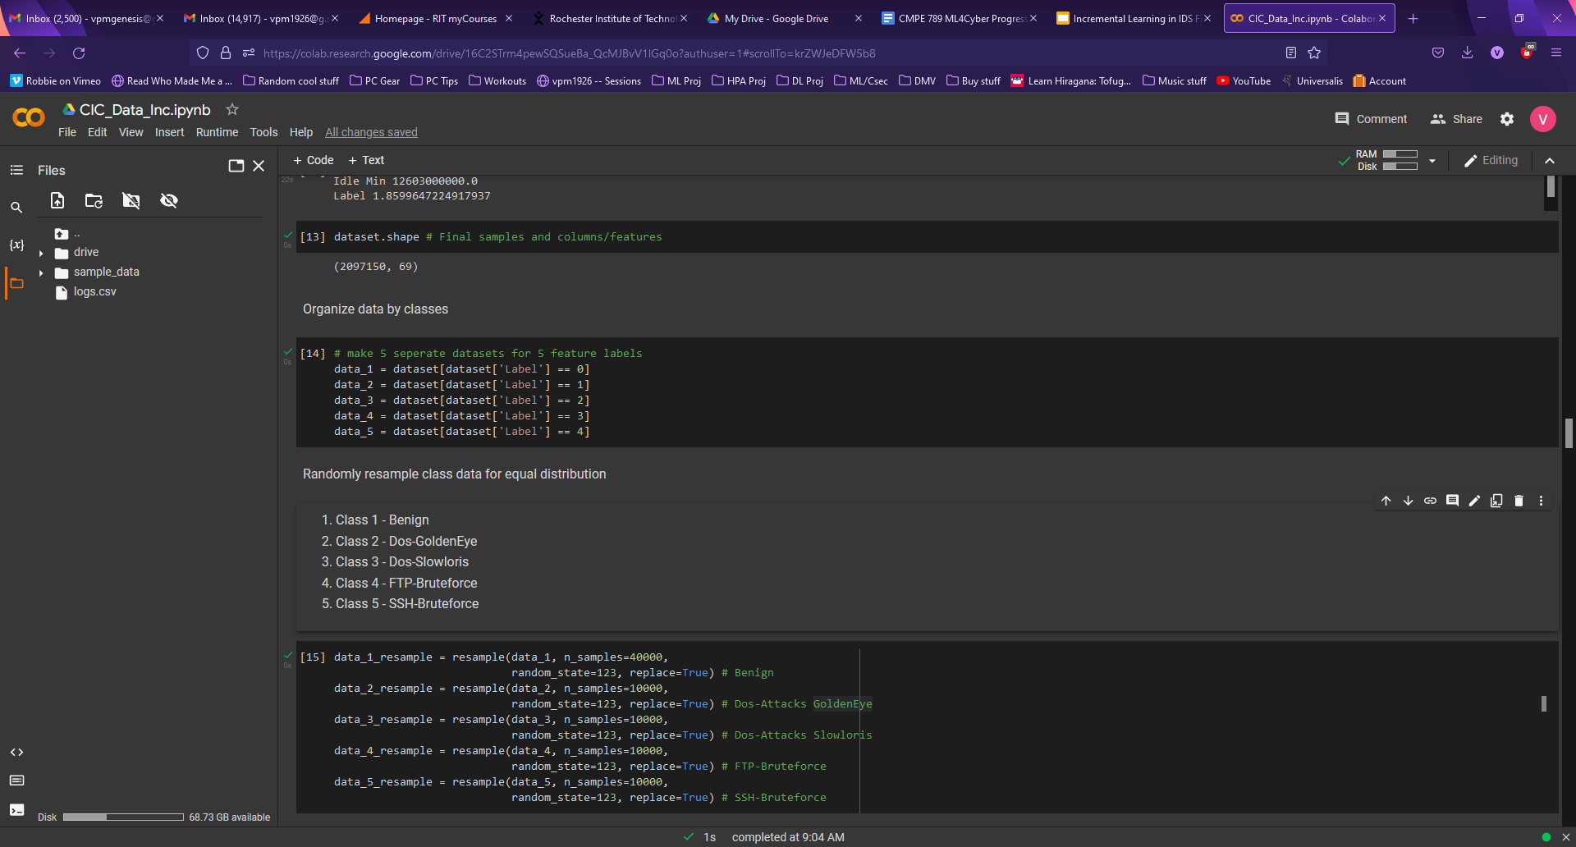
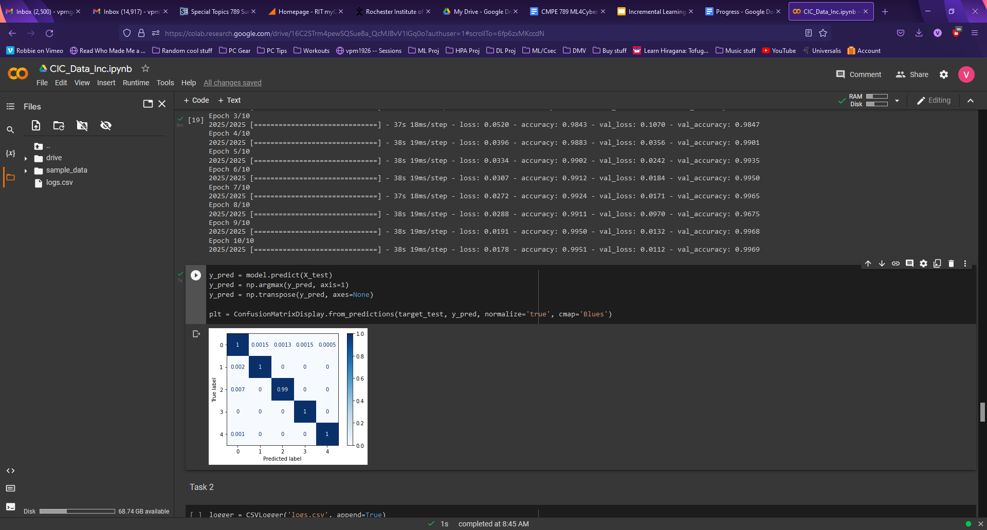
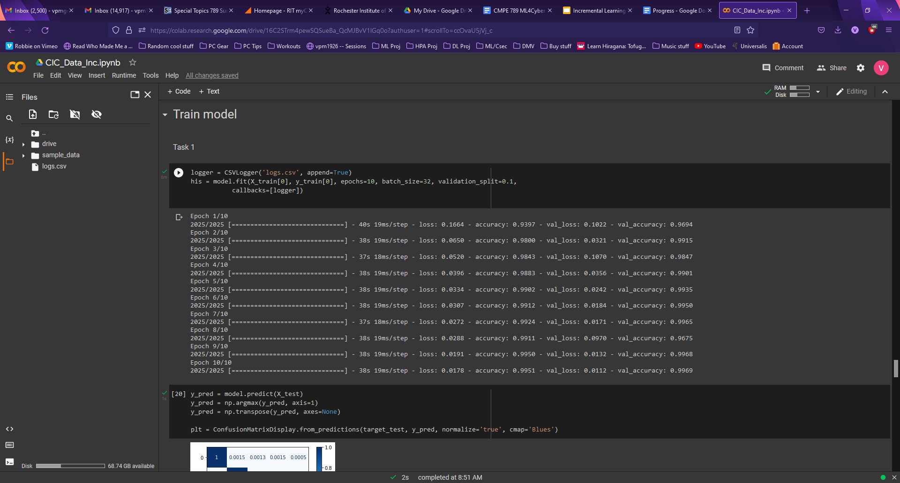
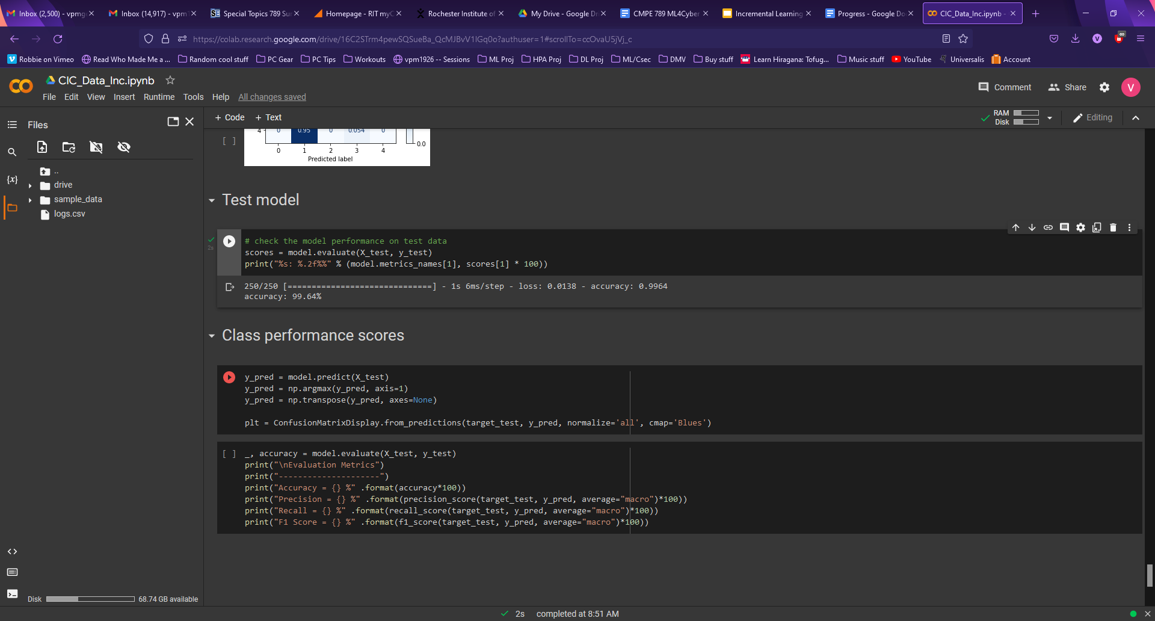
Baseline test
Trained on all 72,000 samples at once for 10 epochs

Slide 7
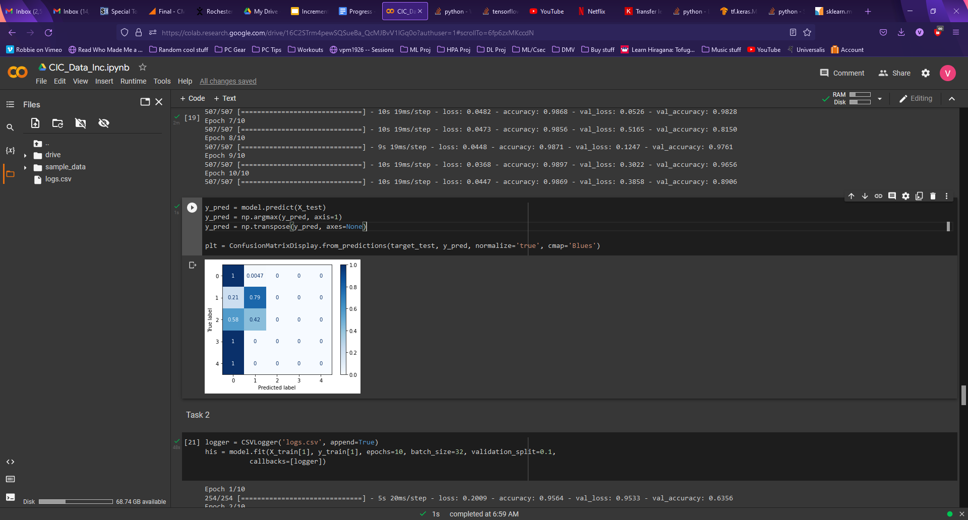
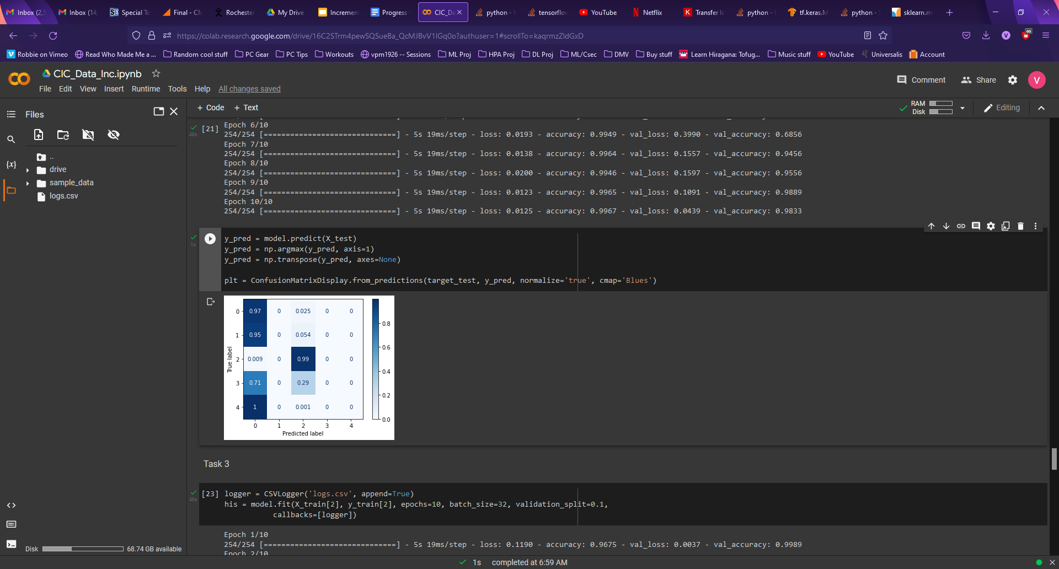
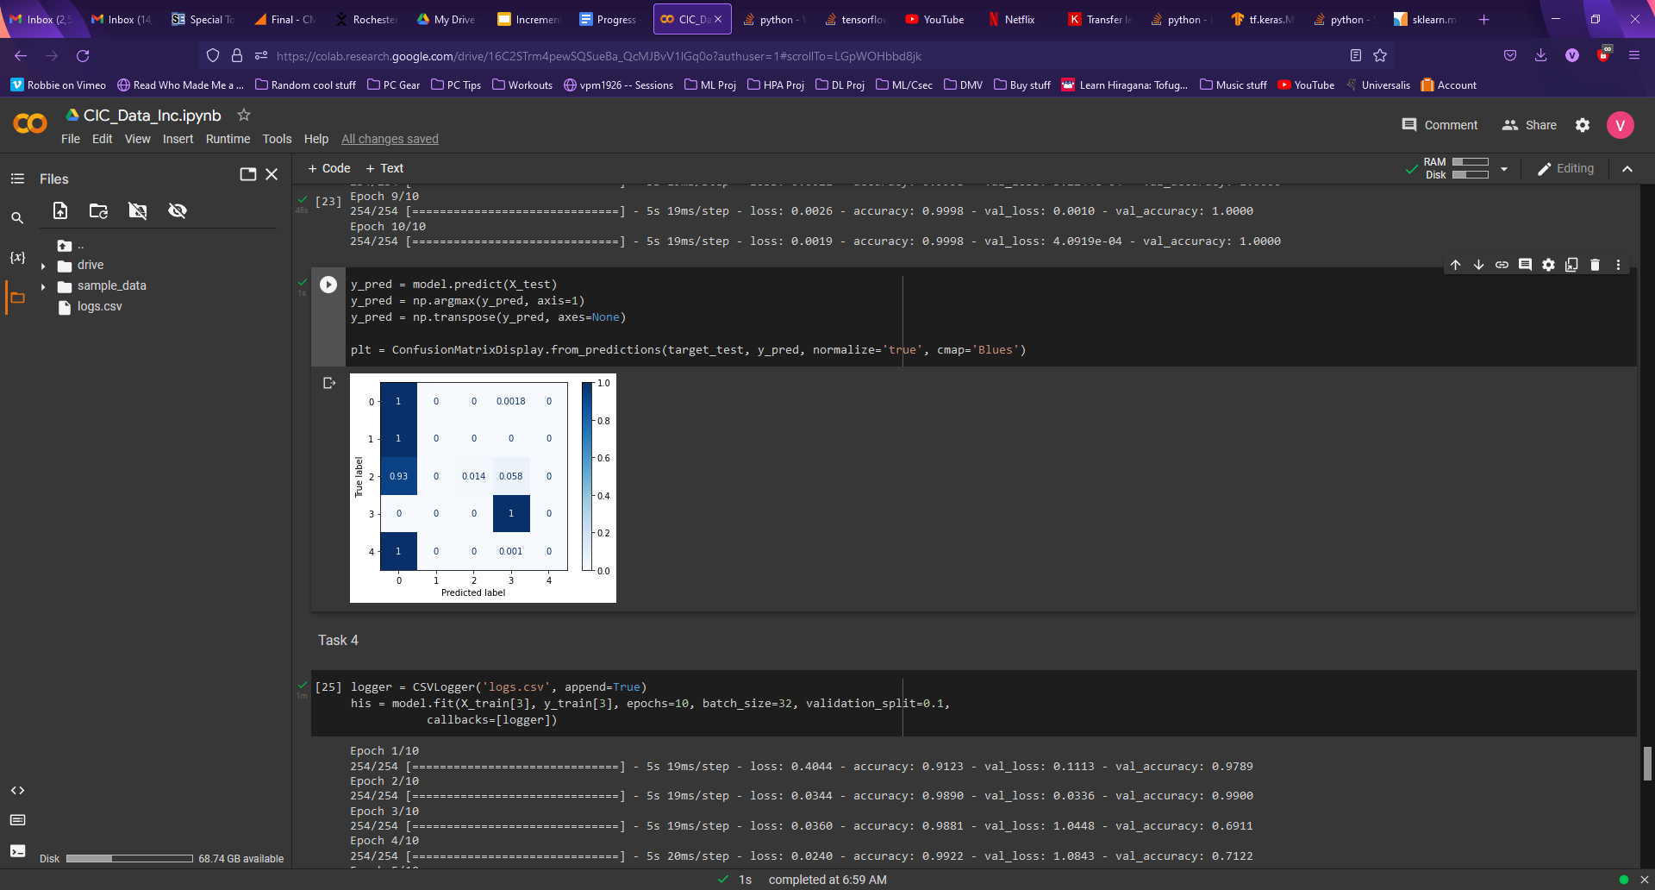
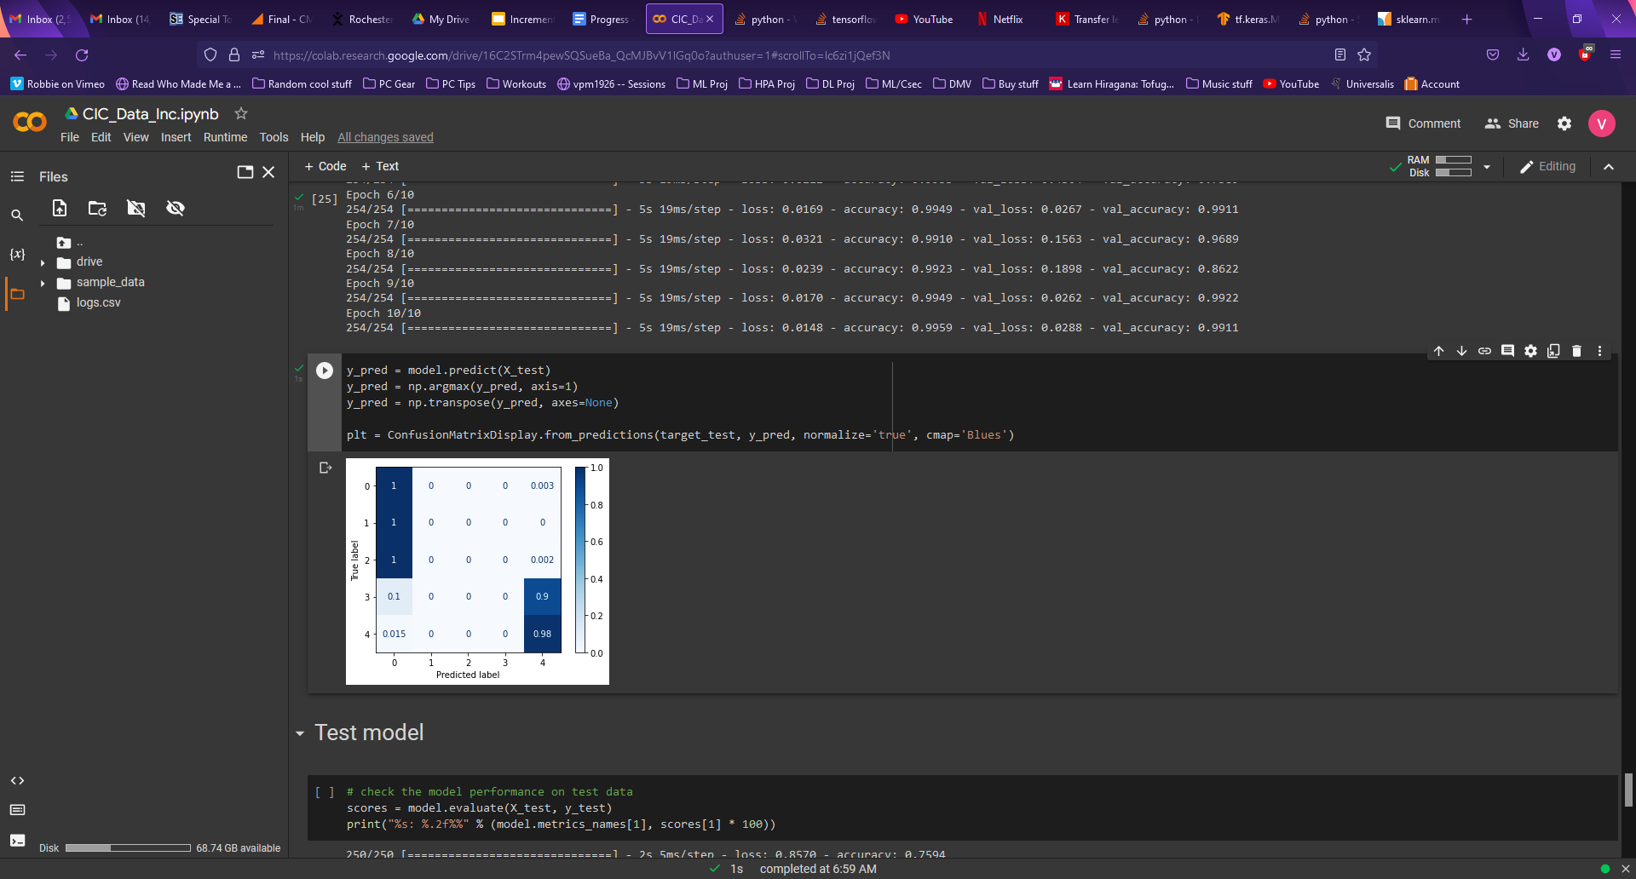
Incremental
Equal distribution between class-split tasks, 50:50 split b/w Benign and Attack for each (9000 samples each).
Total of 18,000 samples per task (all 72,000 samples).
Used smaller increments compared to initial task, results were still relatively similar.
Increments with only 2 classes ends up retraining the model like a binary classifier

Slide 8
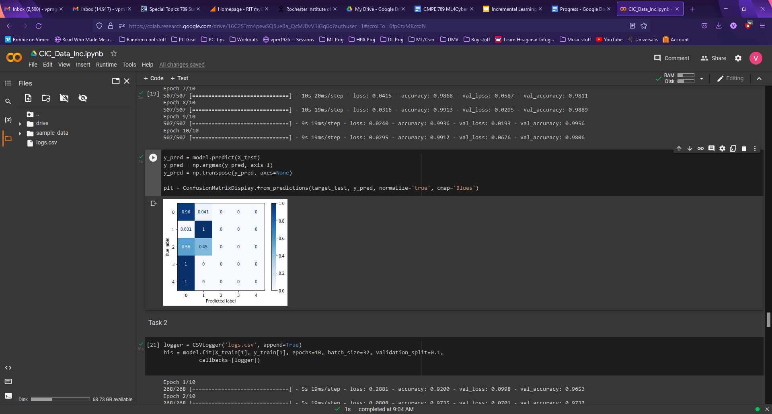
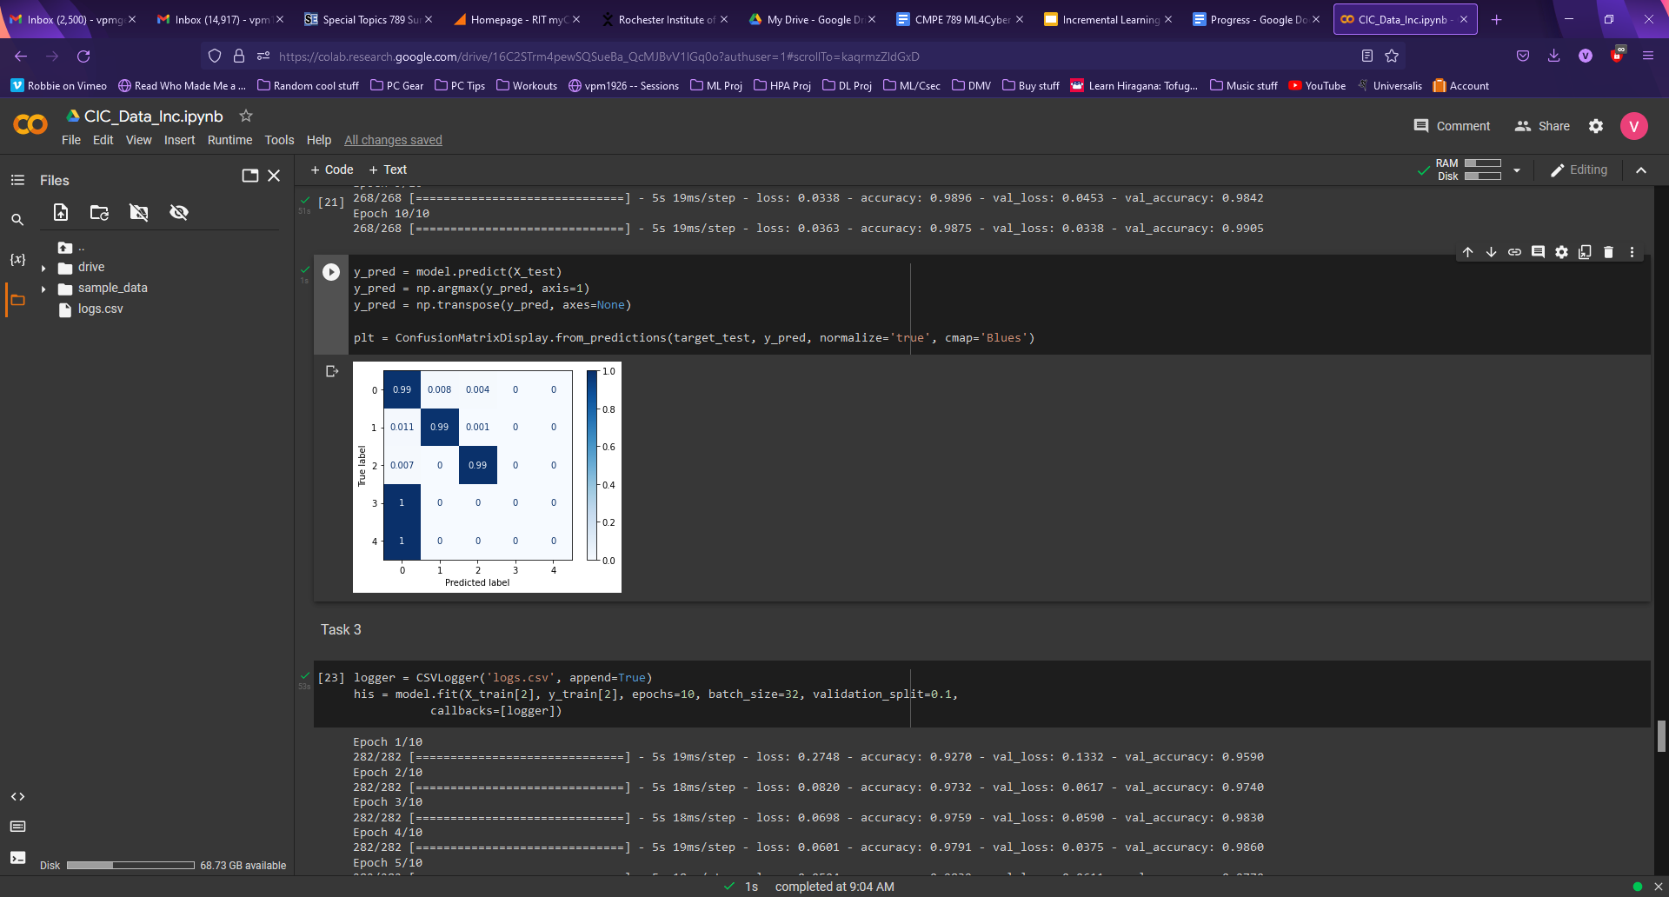
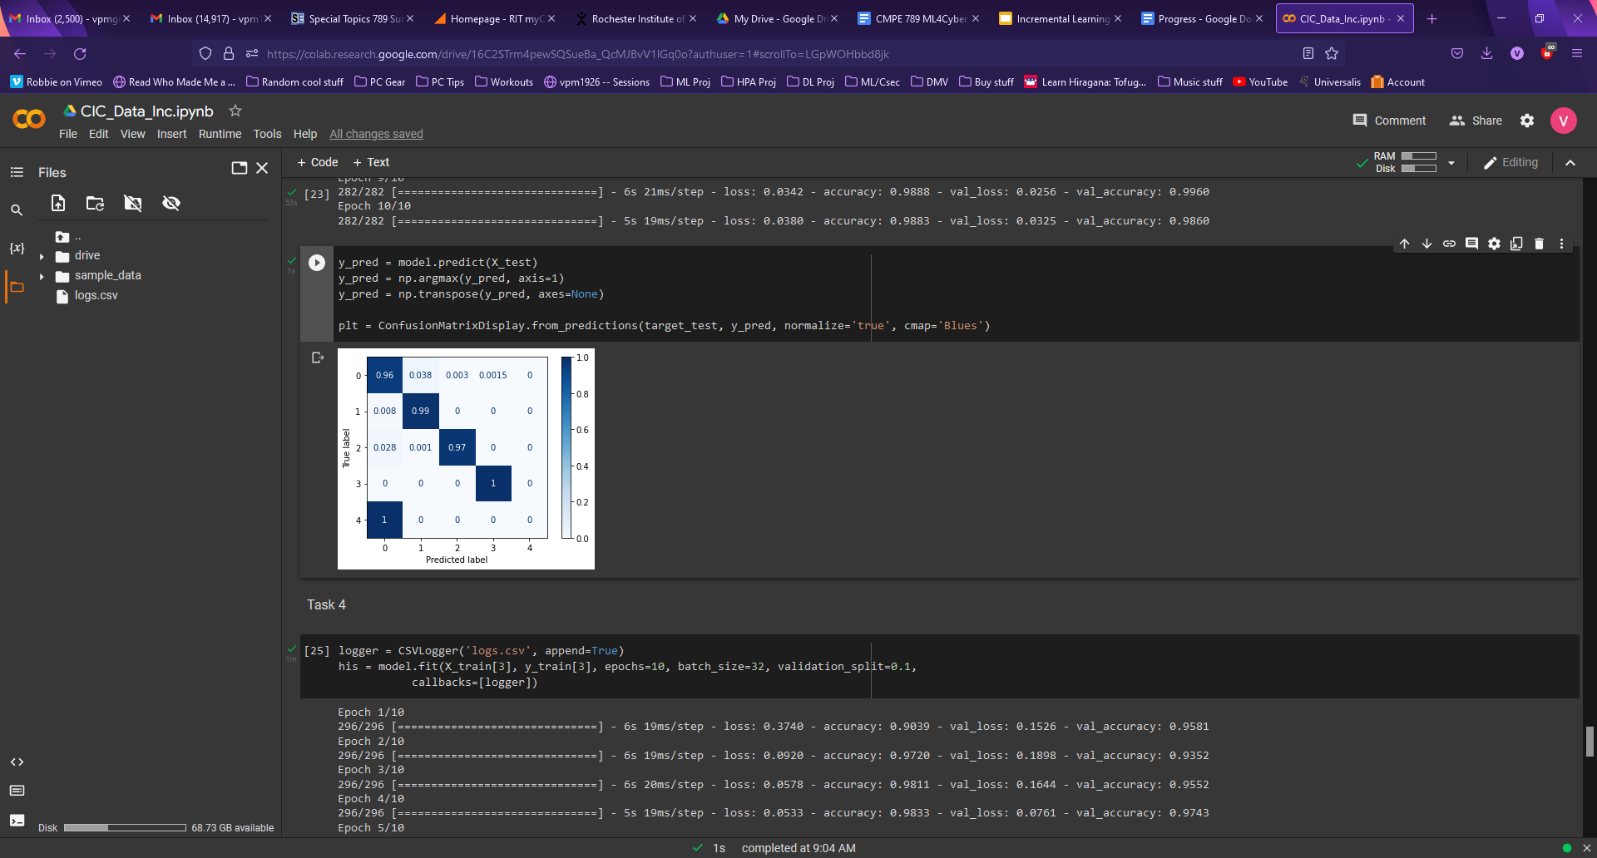
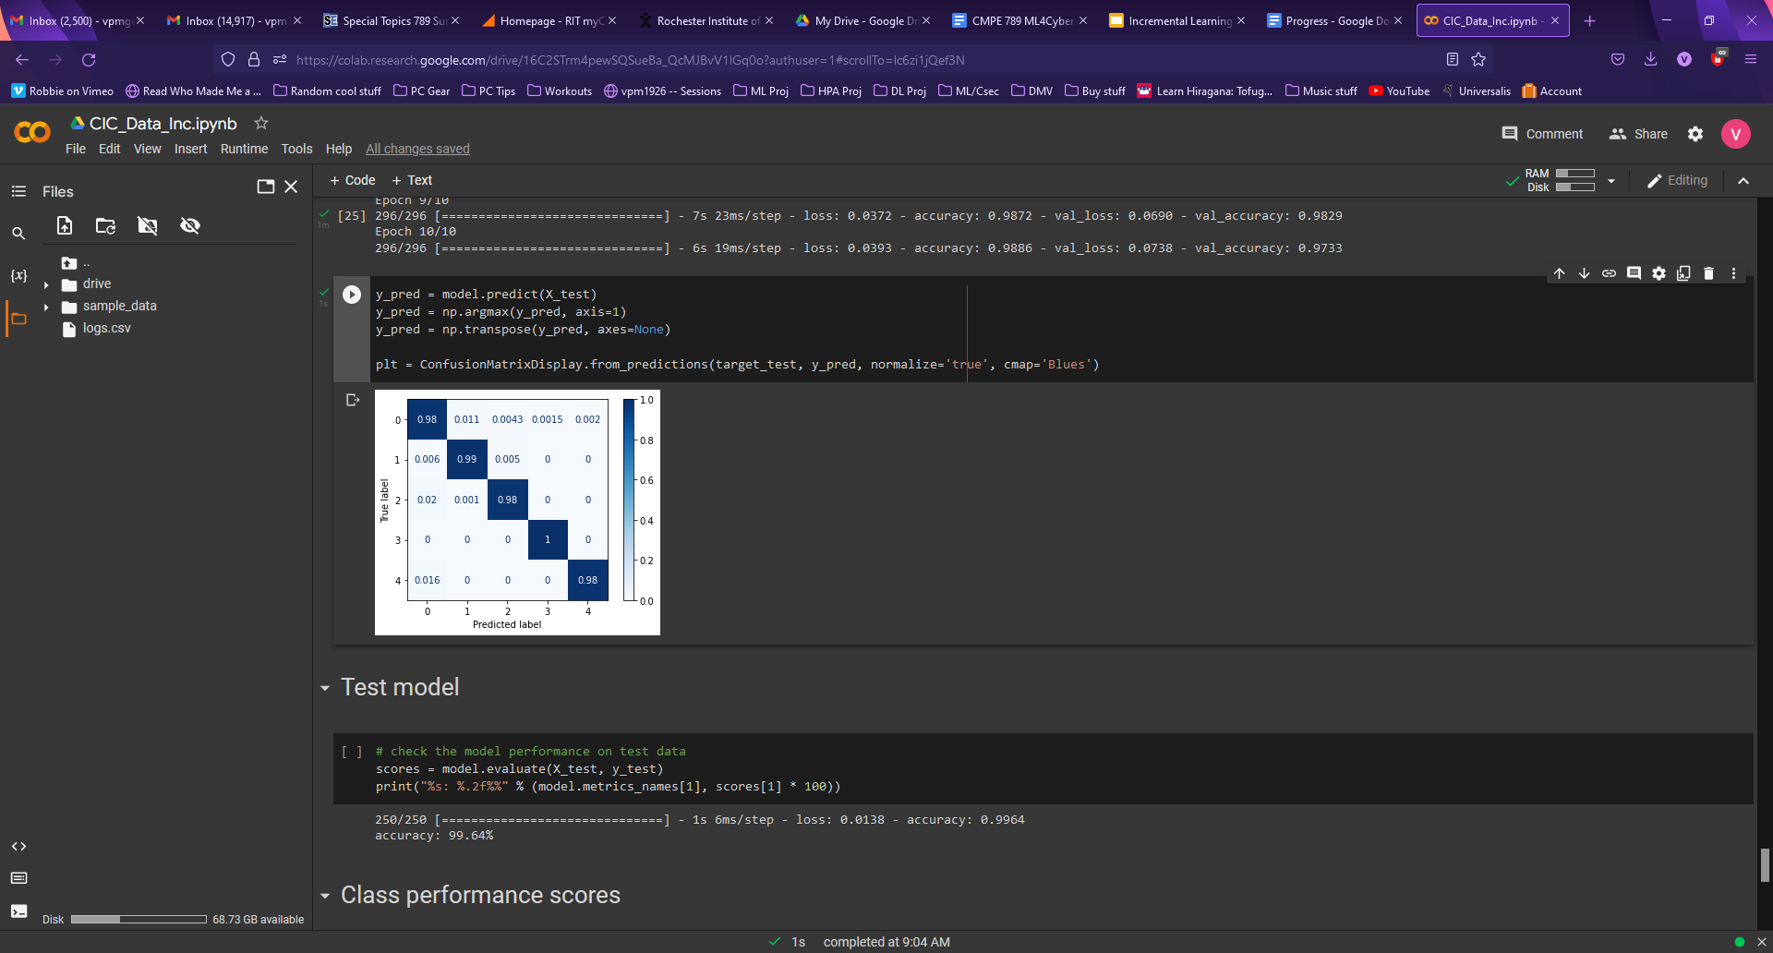
Incremental with Replay
Looked to Replay, mixing in some data from previously learned classes for each task
Task 1: 9000 Benign, 9000 attack 1
Increments: 4500 Benign, 4500 new attack, 500 each of learned attacks
Total of 45,000 samples

Slide 9
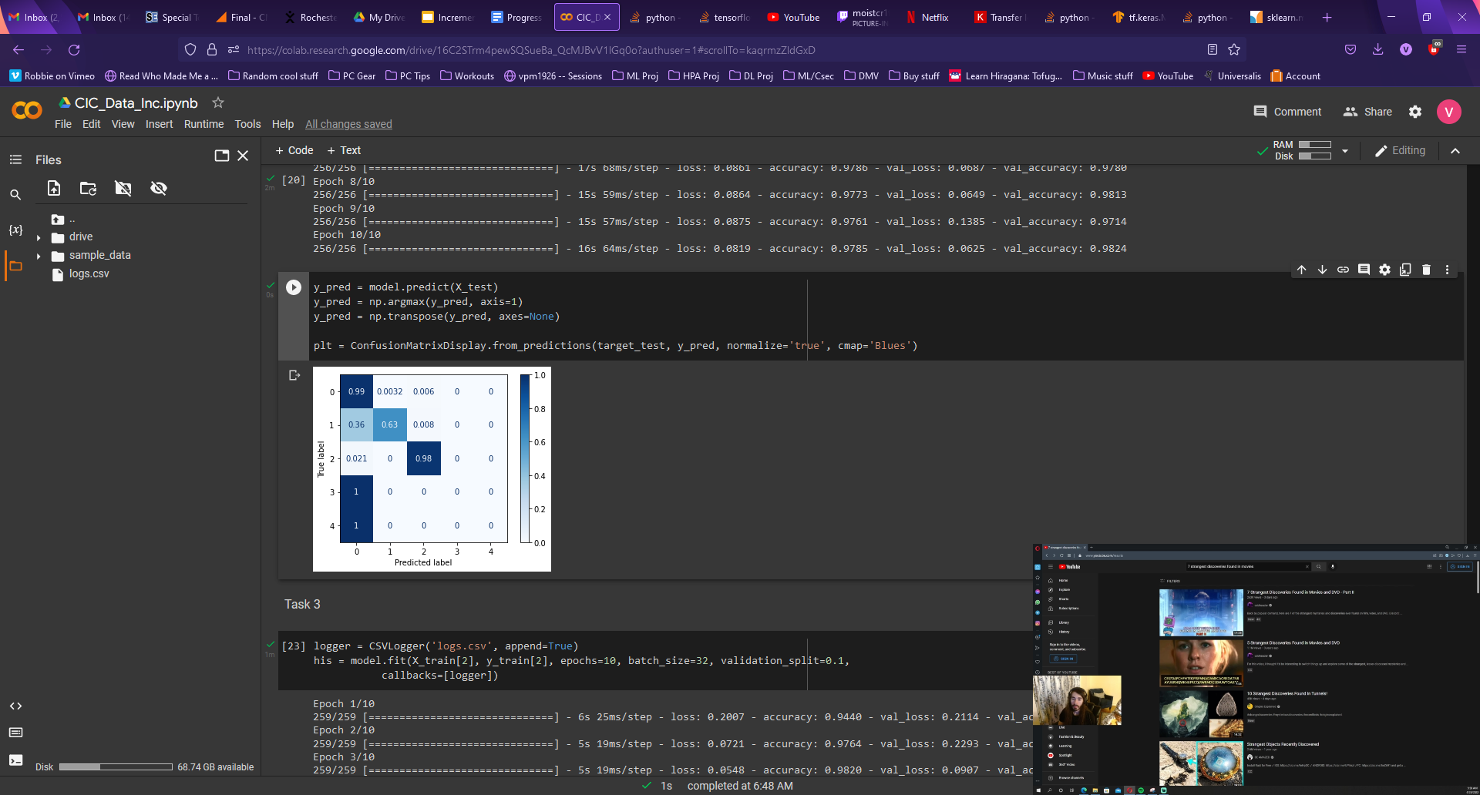
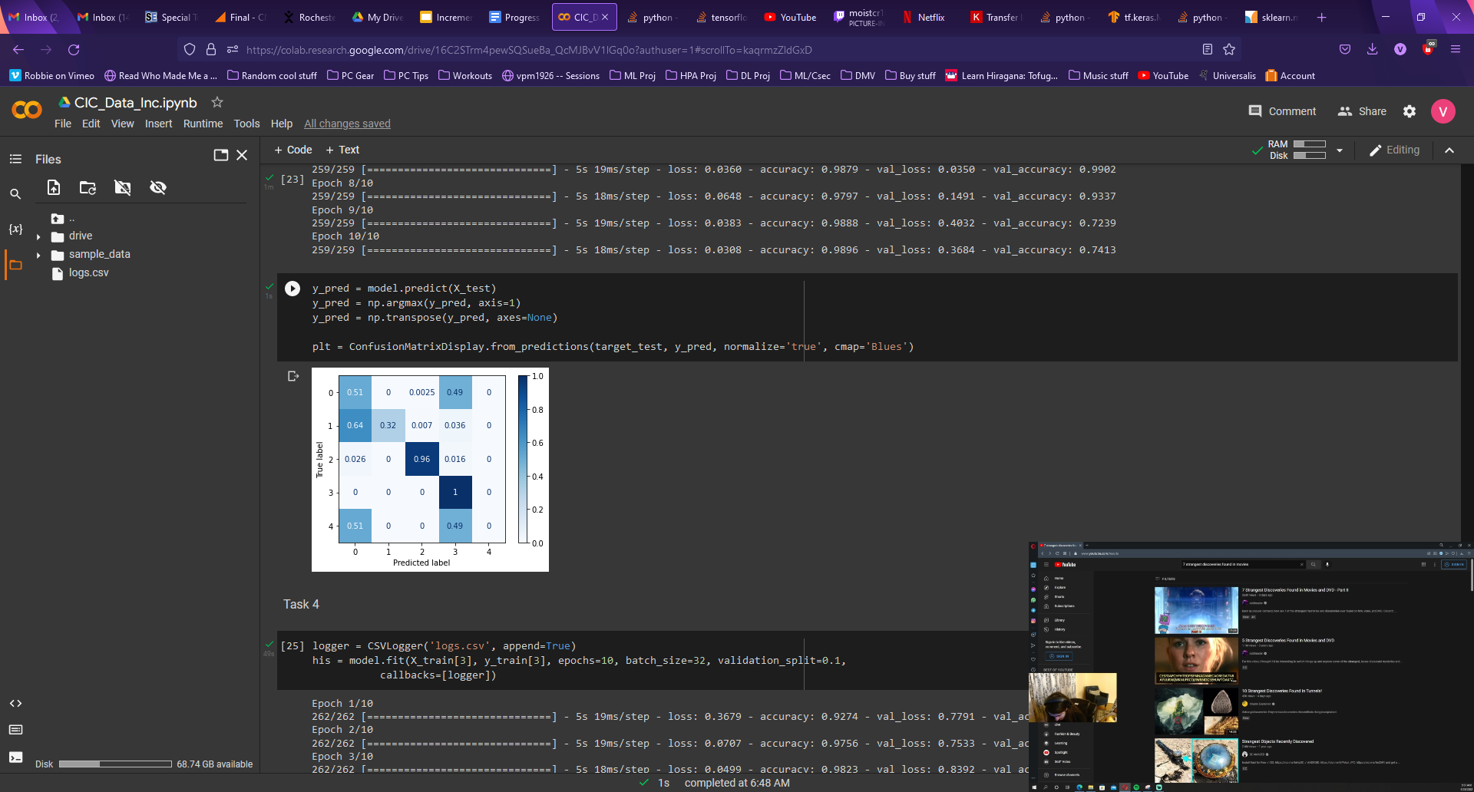
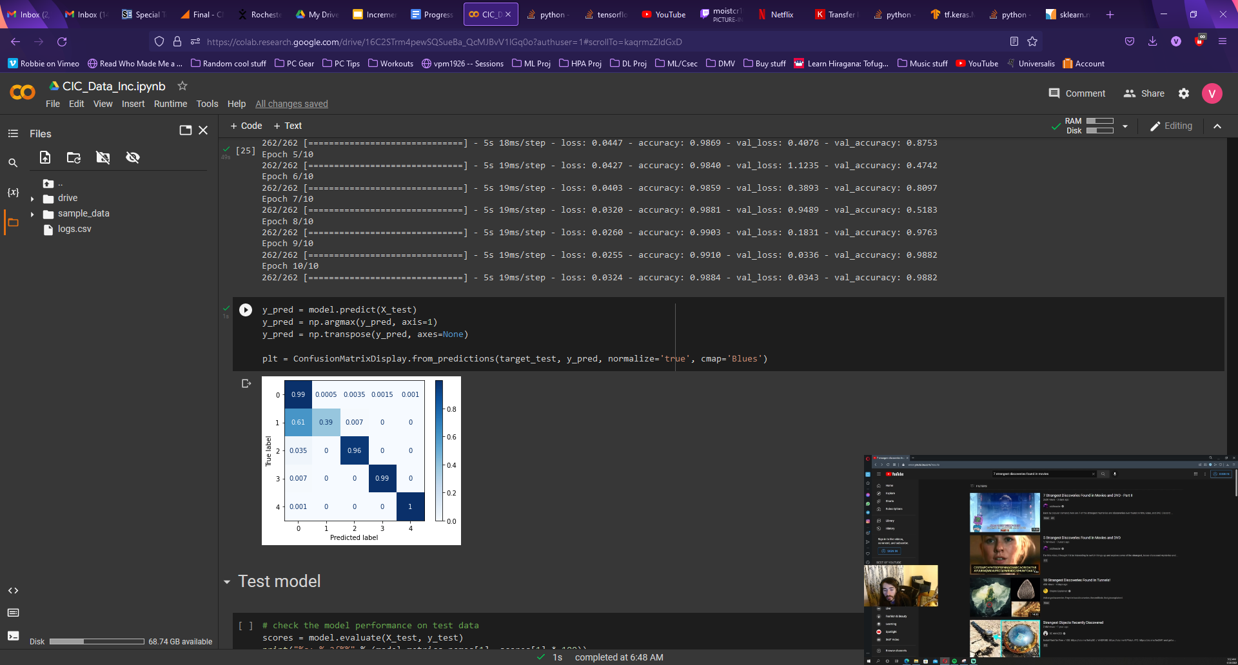
Incremental with Replay - Task 1 omitted
To check base training had an effect: omitted base task
Started with Task 2: 4500 Benign, 4500 attack 2, 500 of omitted task
Total of 27,000 samples
Noticeable difference in Task 1 accuracy with base training omitted.

Slide 10
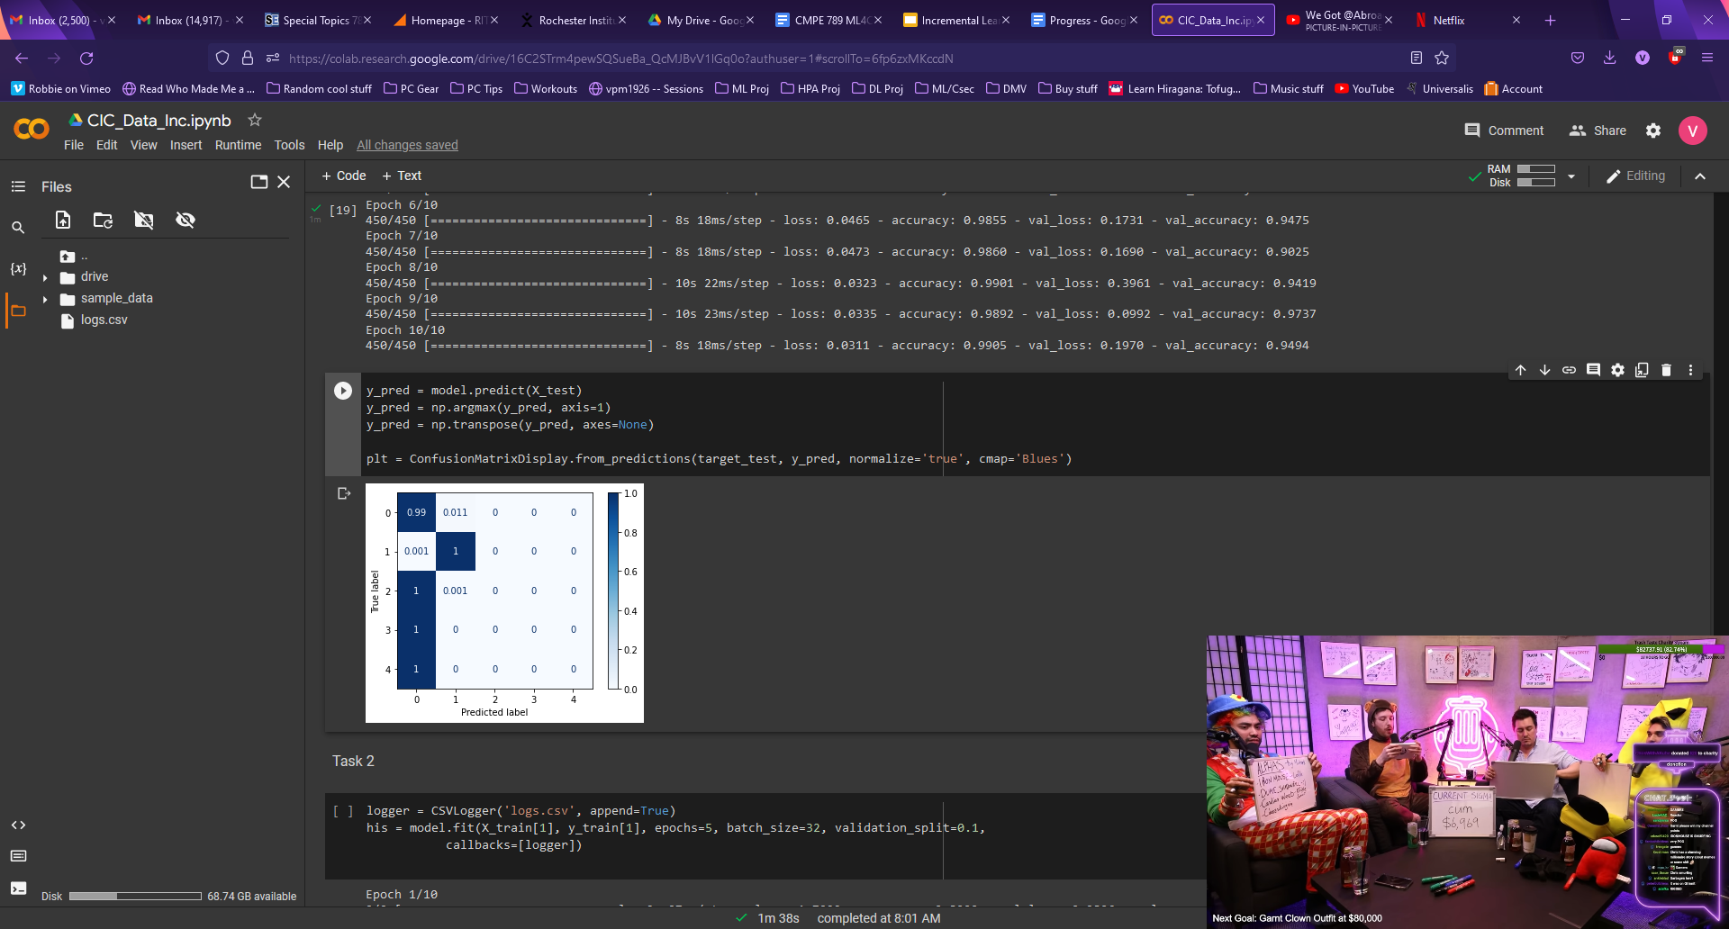
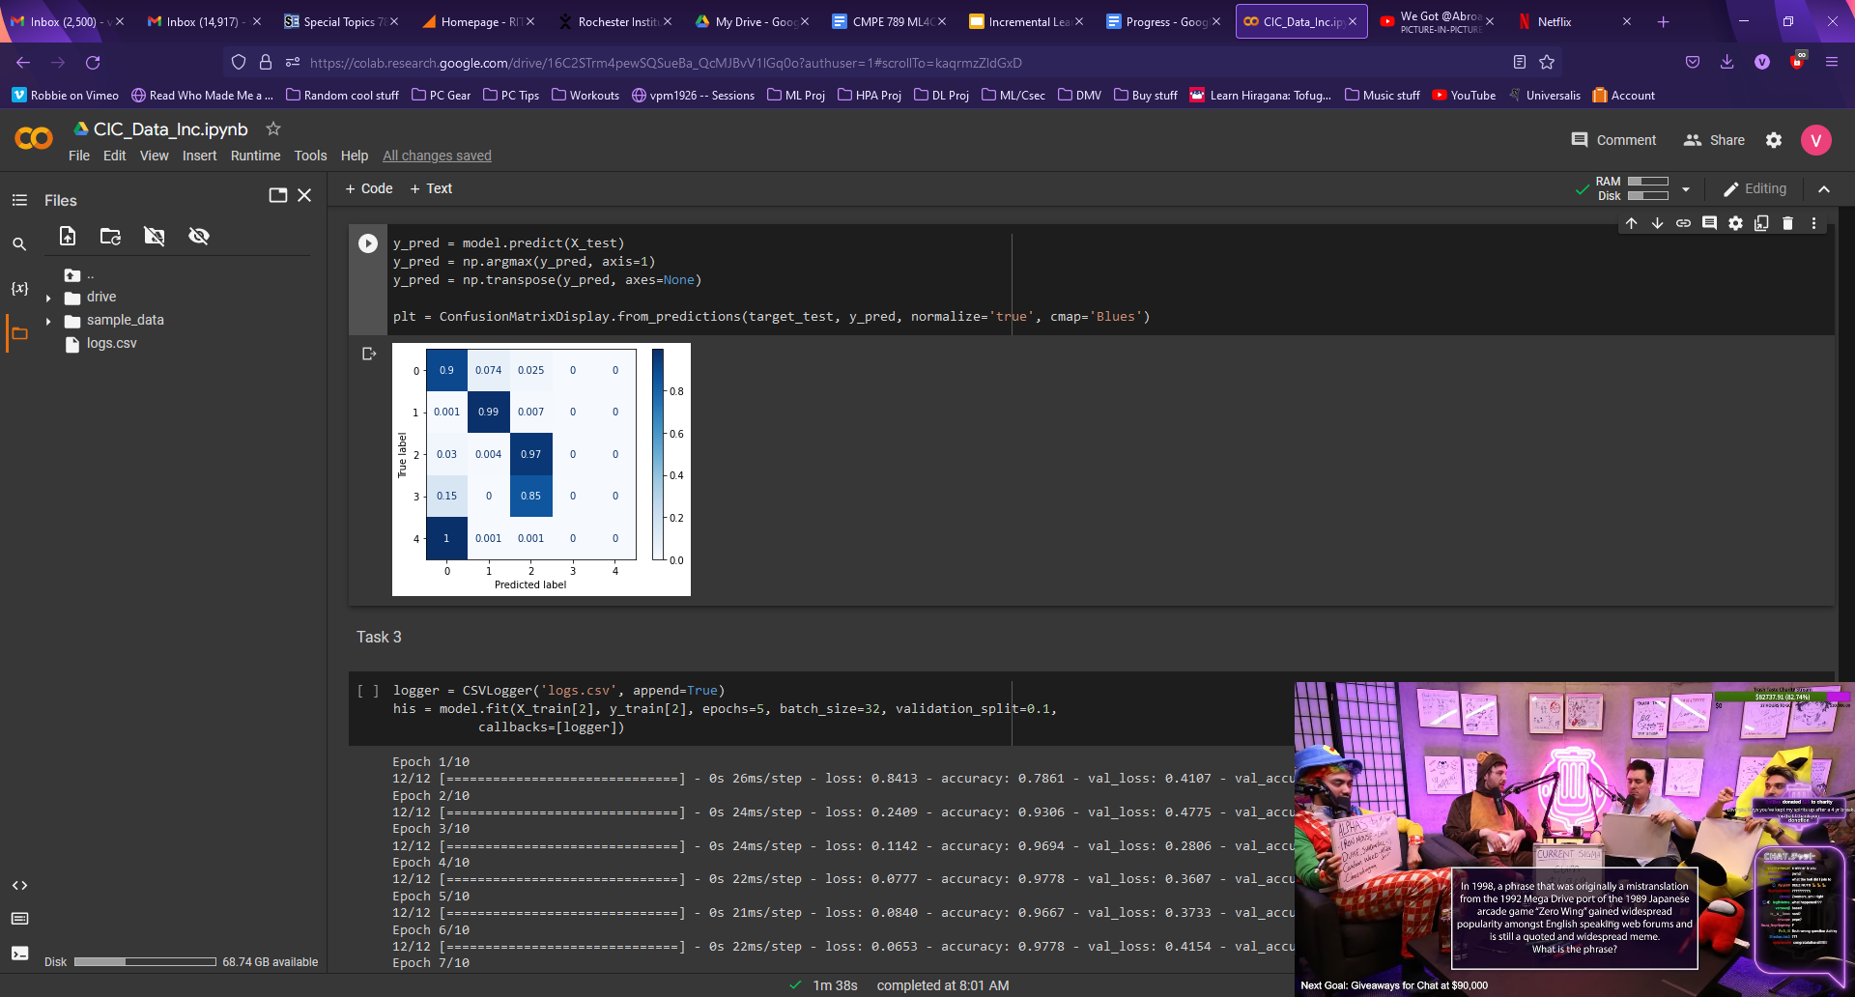
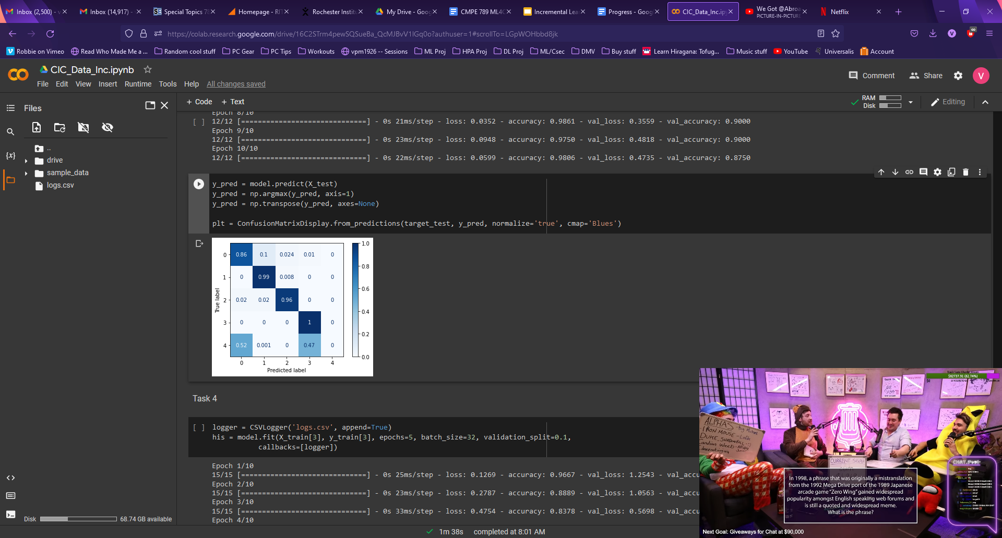
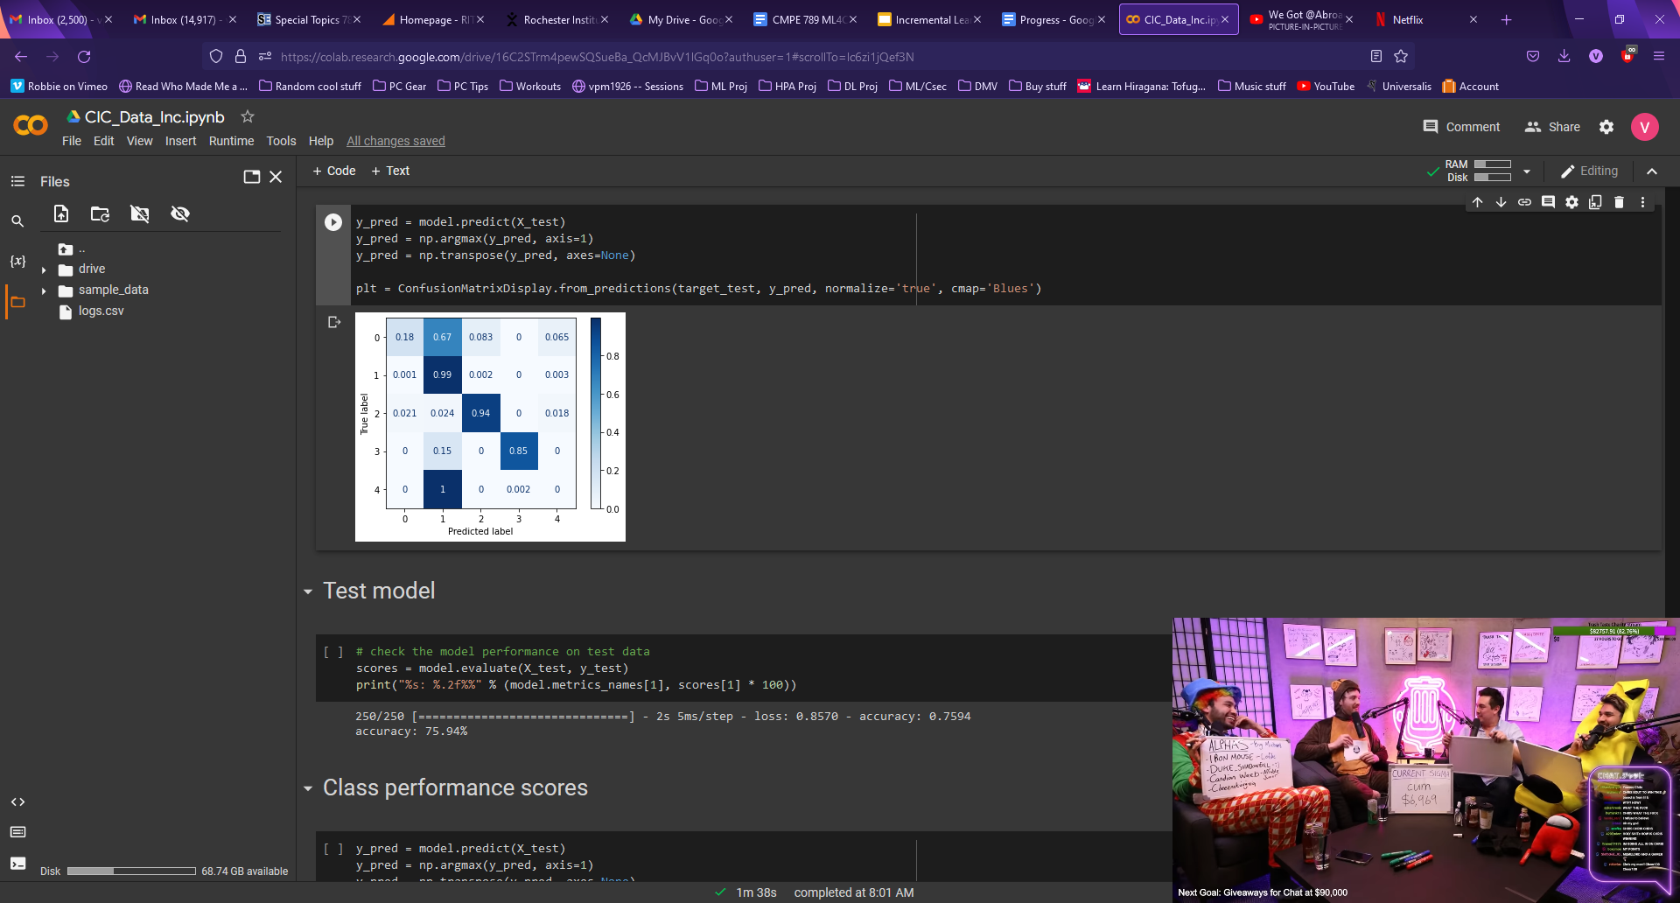
Incremental with Replay - Small increments
Tried to test with smaller increments to approach minimum increment size required. Matched new class data with learned class data.
Task 1: 8000 Benign, 8000 attack 1
Task increments: 100 new attack, 100 each of every learned class (including benign)
Total of 17,200 samples
Potentially 10 epochs for such small increments is too much train time, also indicated by poor validation accuracy

Slide 11
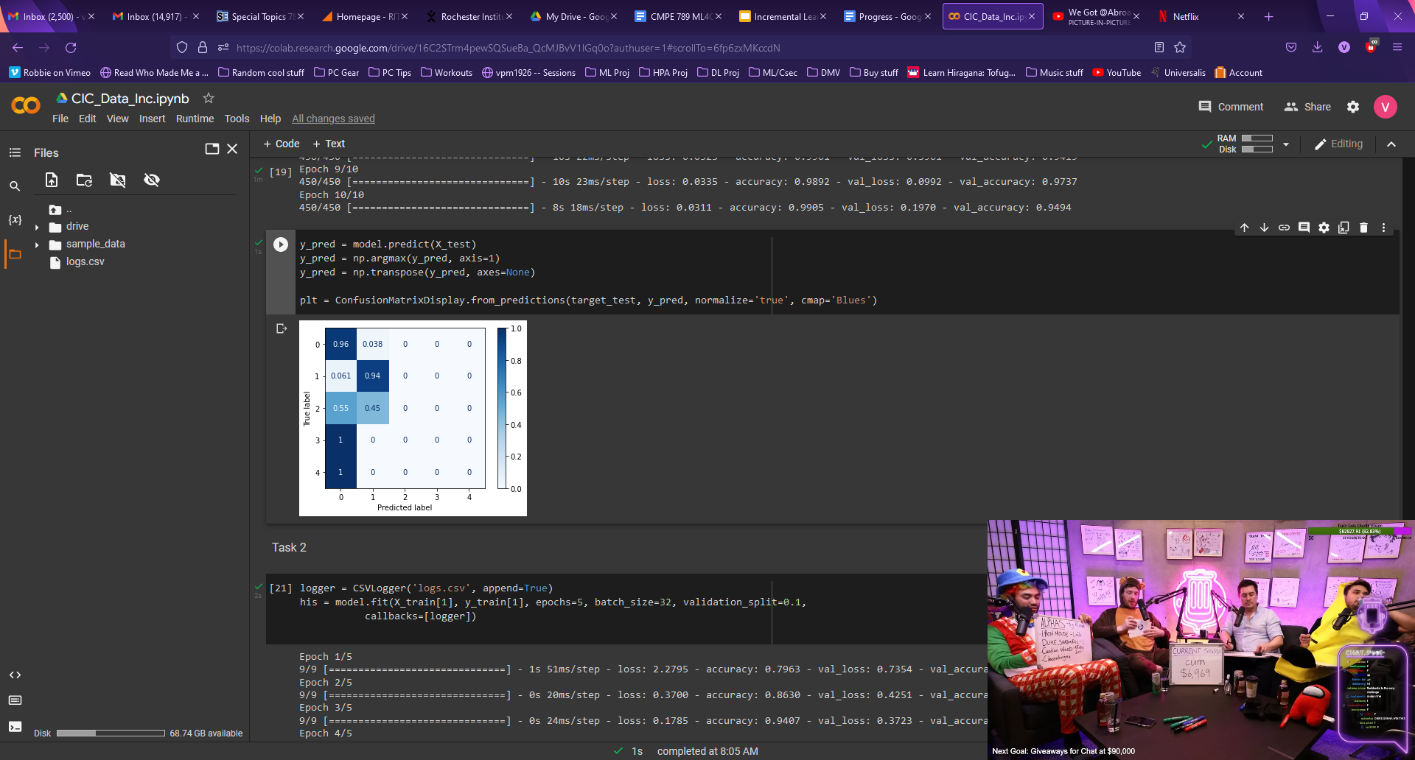
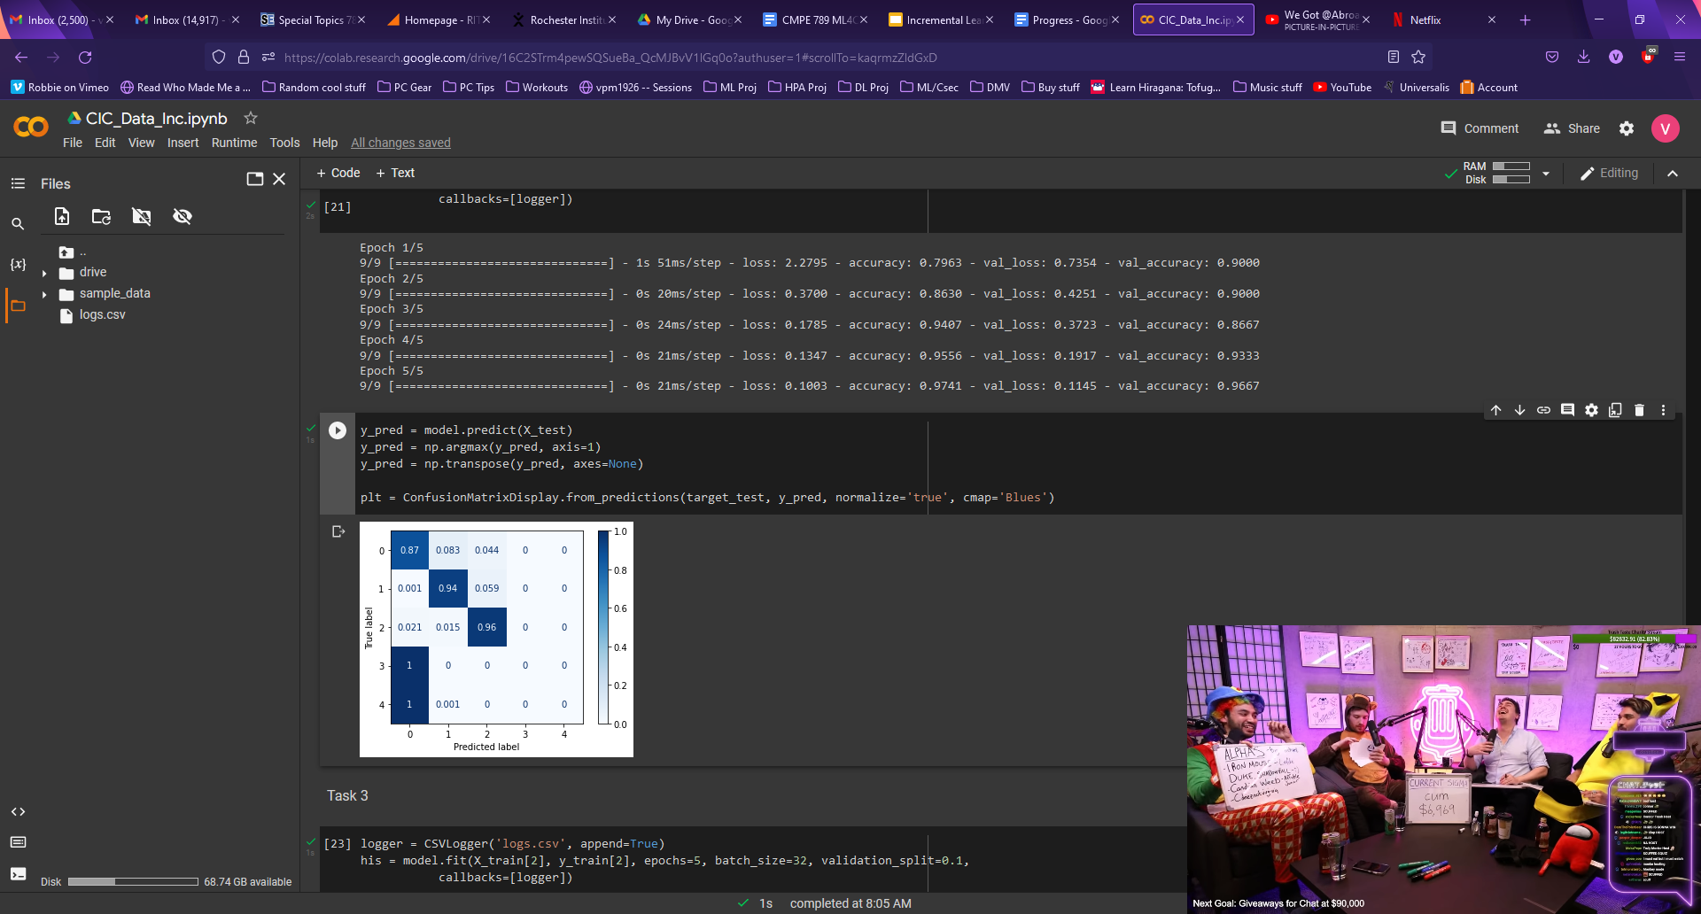
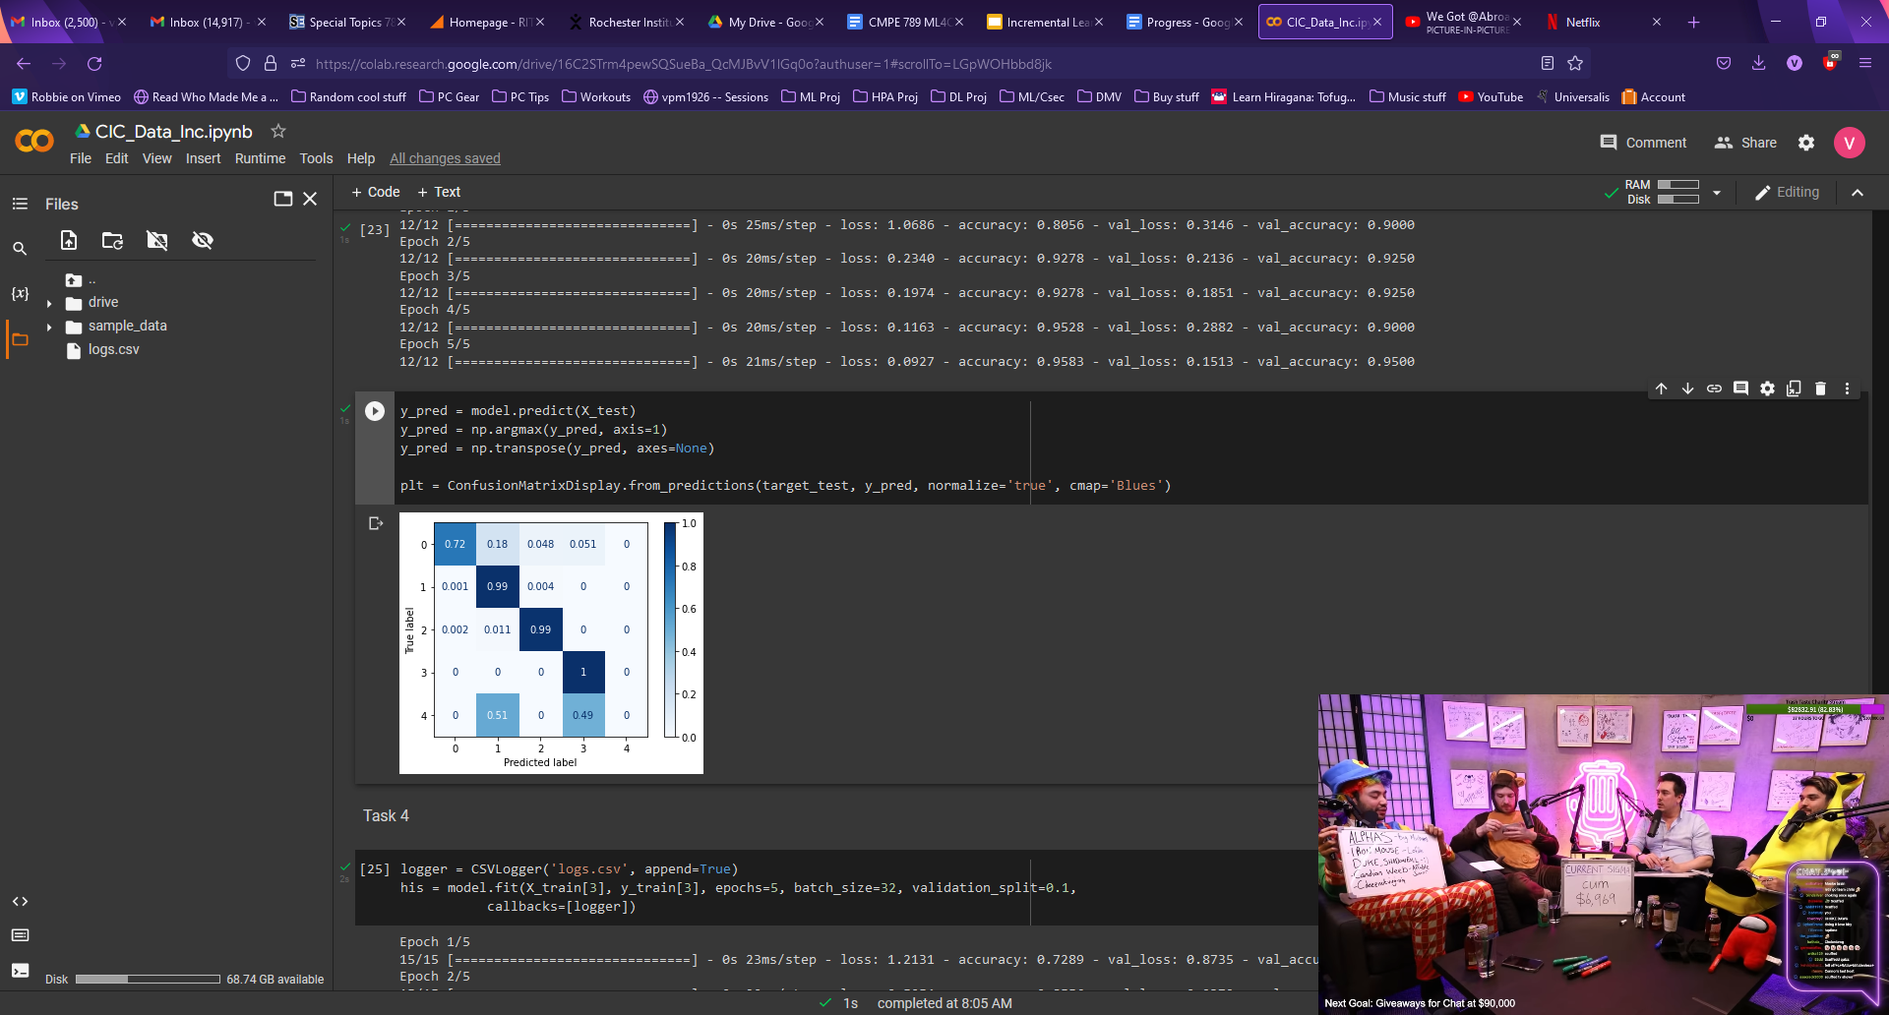
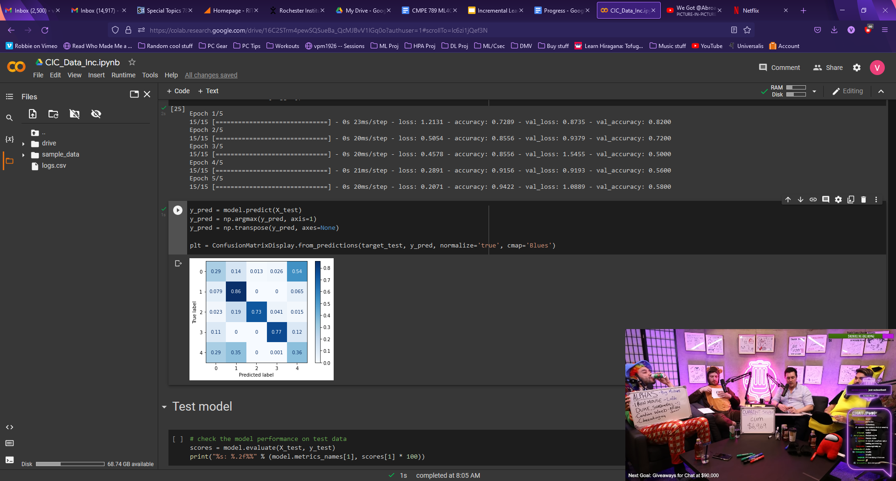
Incremental with Replay - Small increments
Same test but with 10 epochs for base, 5 epochs for increments
Somewhat better overall performance?

Slide 12
Potential Inferences
Classes within each day seem to have similarities/shared feature trends among samples
Simply training with increments of the new attack and benign data ends up retraining the model like a binary classifier
Replay can produce relatively improved task accuracy, requires keeping some amounts of data from previous classes
This could potentially be addressed by training a generative model to produce samples for learned classes to add to the increment

Slide 13
Conclusions and Takeaways
Data pre-processing is a lot more intricate and important than first thought, especially when using non-’sanitized’, real world data
A better understanding of overall experiment design for a ML model from start to finish
Renewed understanding of the importance of starting early

